Slide 1
ISBN 020a and ISSN 022a in shared folder “Bibliographic Details”
Yoel Kortick. Senior Librarian

Slide 2
Introduction

Slide 3
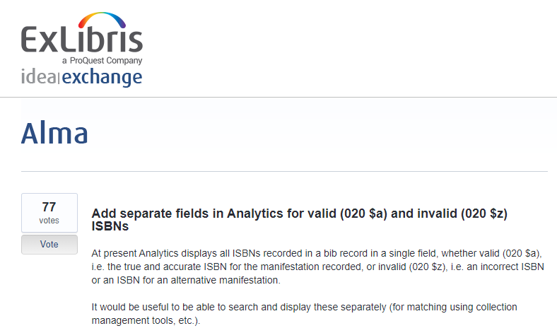
Introduction

Slide 4
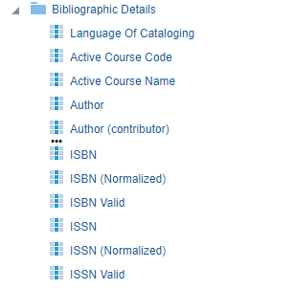
Introduction
Two new fields - ISBN Valid and ISSN Valid were added to all Bibliographic Details folders:

Slide 5
Introduction
For MARC 21 –
ISBN valid contains 020 subfield a.
ISSN valid contains 022 subfield a.
For UNIMARC –
ISBN valid contains 010 subfield a.
ISSN valid contains 011 subfield a.

Slide 6
Example

Slide 7
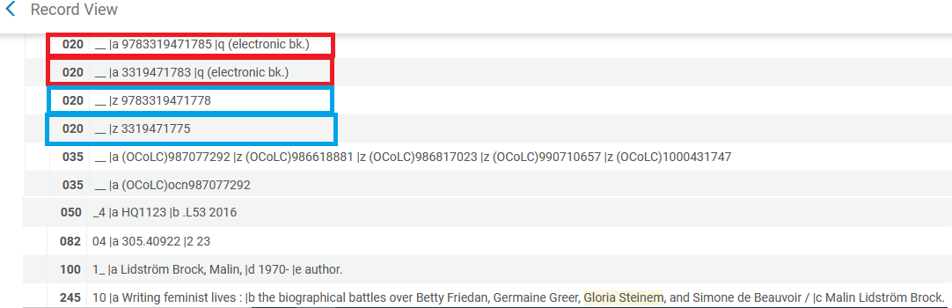
Example
In the MARC 21 record below, we have two 020a: 9783319471785 and 3319471783 and two 020z: 9783319471778 and 3319471775.

Slide 8
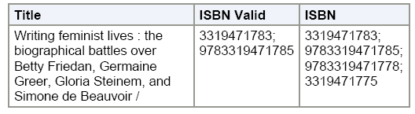
Example
And here they are in Analytics:
020a
020a, 020z

Slide 9
Yoel.Kortick@exlibrisgroup.com

